Slide 1
Violence against Children with Disabilities 1
The CRC calls upon all states to take measures to protect all children from violence, including those with disabilities. The CRPD additionally requires governments to introduce specific measures to ensure protection for children with disabilities.
Evidence from countries throughout the world reveals a pattern of disproportionate violence against children with disabilities.
Violence takes place everywhere: the family, schools, the community, the justice system, the workplace and residential care.
Consistent evidence emerges from research that children with disabilities are 3–4 times more likely to experience physical and sexual violence and neglect than non-disabled children.

Slide 2
Violence against Children with Disabilities-2
A 15 country study of severe corporal punishment of children with and without disabilities found that in nearly half of the countries studied, children with disabilities were significantly more likely to experience severe physical punishment; experimentation; abandonment and being left to die; and ‘mercy killing’, a crime often attracting lower penalties, reflecting the lower value attached to their life.
In Thailand, there are reports of brothels specifically seeking deaf girls, assuming that they will be less able to seek help or return home because neither customers, employers nor fellow sex workers are able to speaksign language.

Slide 3
Violence against Children with Disabilities-3
Children with disabilities often face being physically assaulted, stoned, or spat upon on while going to school.
For poor families, and those with limited or no access to social protection or basic services, the birth of a child with a disability can lead to significant family stress resulting in rejection and violence, particularly where the child is physically dependent on others to provide care, or has reduced ability to recognize danger or protect themselves.
Stigma and fear often leads to children with disabilities being hidden away and denied access to other children. They may be isolated from neighbours, the extended family or local community members, rendering it less likely that violence or abuse, perpetrated by family members, is identified or reported.
Some forms of violence are specific to children with disabilities: abuse defined as behaviour modification, including electroconvulsive treatment, drug therapy and electric shocks; the practice of forced sterilization of girls with disabilities; exposure to medical or scientific

Slide 4
Violence against Children with Disabilities-4
In Taiwan, a study found that the proportion of children that were sexually exploited engaged in sex work who had mild developmental disabilities was six times greater than what might be expected from their incidence in the general population.
Protection systems and reporting mechanisms commonly fail to take account of the needs of children with disabilities. They therefore experience difficulties in accessing help and if they are able to do so, they rarely get access to effective justice or redress’
The Secretary-General’s Special Representative on Violence against Children, in a report on counselling, complaint and reporting mechanisms, highlighted the particular challenges faced by children with disabilities in seeking redress.

Slide 5
Violence against Children with Disabilities-5
Violence is everywhere – in mainstream and integrated schools as well, but especially out of it – in institutions/special schools for children and young people with disabilities.
There is violence in the fact that the ‘regular’ school is denied us.
And with this educational exclusion, is our exclusion from of all the life skills which mainstream education can offer, such as sexual and reproductive health education and information.

Slide 6
Challenging Disablist Bullying in Schools -2015 World of Inclusion/ Anti Bullying Alliance Joint Project
Richard Rieser
www.worldofinclusion.com

Slide 7
Reasons why bullying is prevalent
Inclusion leads to a wider diversity of young people with different physical and mental impairments being in school with non-disabled peers.
Increasing insecurity is a feature of many education systems, as competition replaces collaboration. Scapegoating of those who are different becomes common.
This is not inevitable. If teachers and others who work in schools and young people themselves challenge the prejudicial thinking, its root causes and make young people aware of the very harmful psychological impact that bullying has, it can be eliminated.
This work on disabilist bullying commenced with a number of resources produced for school staff.

Slide 8
What we did
Following the preparation of guides for teachers, ABA has worked with Richard Rieser to develop some materials to help challenge disablist bullying in schools with school students or pupils.
The workshop was led by a disabled adult with an education background. The workshops were based on social model thinking and an historical analysis of the oppression disabled people have faced.
The groups were made up of disabled and non-disabled pupils.
After a day’s workshop the group had to develop a presentation to their peers the next day. The workshops generated a great deal of interest and on-going work in the schools.
We went to six schools (4 primary and 2 secondary) to test out our materials. As a result, we have created six short films to give ideas about challenging disablist bullying in school.

Slide 9
Activities
Explain children with disabilities more bullied. Is this fair?
What is disability-common impairments group decides should be in/out the circle
Write all words to do with disability they know. Circle those positive.
Explain barriers disable Build wall of barriers on card.
In groups come up with solutions to the barriers
Disability detective. In pairs examine info sheet different groups of impairment answer questions.
Where do negative words come from?
History of our oppression fit different slides on time line.
View Case study cartoon of bullying-animation
Given other real life examples. Come up with solutions

Slide 10
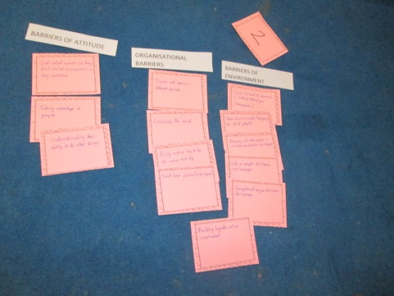
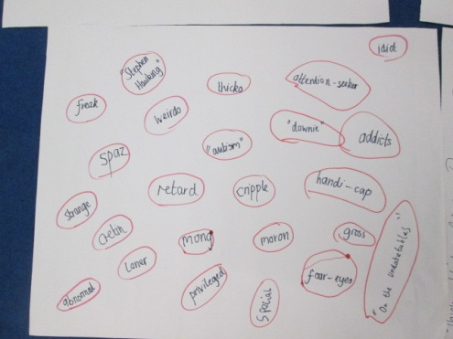
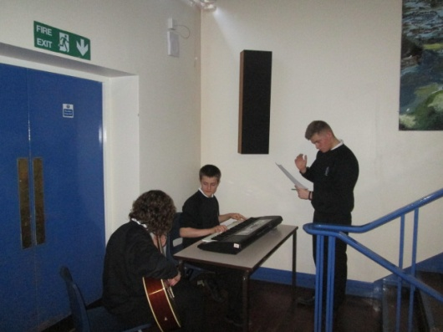
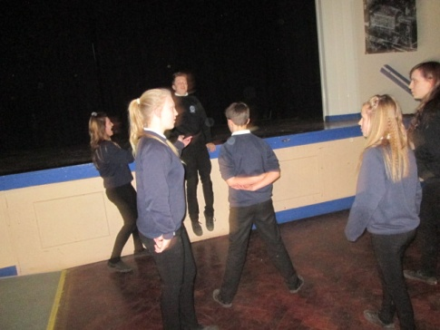
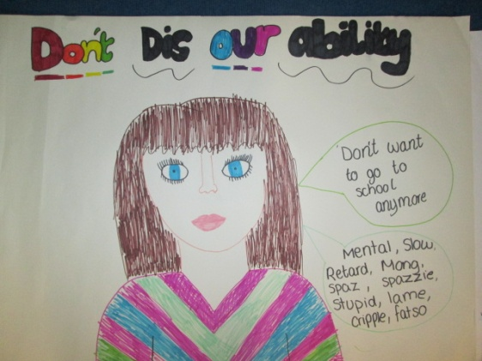
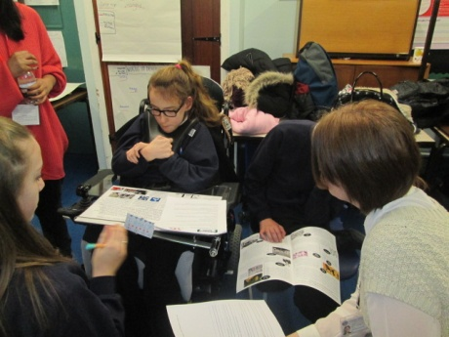
Preparing Presentation for Peers of What We Learned
Make Posters
Drama Role play
PowerPoints
Speeches
Where certain words come from
Impact of bullying/hate crime
Barriers-solutions
Write and perform songs
How to deal with bullying
Working in Groups
Identifying Barriers
What Language we use
Performing Songs
Don’t Dis
Our Ability
Making Posters
Role Play

Slide 13
Videos of 6 Workshops
Wroxham Primary School - Potter’s Bar https://www.youtube.com/watch?v=WJn8NoC7-Z0
Priestnall Secondary School - Stockport https://www.youtube.com/watch?v=QZ4L3HAIBjk
Highbury Quadrant Primary School - London https://www.youtube.com/watch?v=FBDaWTokuK4
Fulford Secondary School - York https://www.youtube.com/watch?v=hb0Kl_hgjBI
Emerson Green Primary School - Bristol https://www.youtube.com/watch?v=Hbu6RYgxHi0
Colmore Junior School - Birmingham https://www.youtube.com/watch?v=mZrXNWMIbcc

Slide 14
Lessons learned from this project
Young people are generally ignorant of the history of the treatment of disabled people and benefit greatly from this knowledge in developing empathy for disabled people.
Young people do not know the origins of disablist language and its derivation. Once given a firm grounding they are prepared to challenge disablist language. Words such as mong, retard, spaz and idiot are harmful and in wide use in society.
A disabled adult, with some educational background, is best placed, through explaining their own experiences and generalising them, to run such interventions. Failing this, staff who lead such interventions should be well versed with a social/human rights approach to disability rights and the history of disabled peoples’ oppression.

Slide 15
Lessons Learned -2
Groups that undertake this work should be given opportunities to share what they have learned with their peers.
School staff have not generally been exposed to the above and do not know how to effectively challenge disablist bullying. They need disability equality training and to be taught how to effectively challenge disablist bullying.

Slide 16
Brining the Paradigm Shift into Behaviour-Using Restorative Justice
Restorative Methods
Emphatic Listening
Restorativve Conferencing
Mediation
Restorative Circles
Circles of Friends
Child to Child approaches
Family Conferencing
Victim Empathy
Restorative Justice

Slide 17
Features of a Restorative School
Bravely takes a new look at traditional process of educating
Centrality of judgement, deficit and failure is replaced by appreciation, alternative possibilities and hope
Issues are addressed rather than students punished
Teachers see themselves in equal relationship with students and their parents, not as authorities over them
The school community is committed to the integrity of its members
People speak respectfully to each other
Students learn that living in a complex communities not only possible, it is enjoyable
School achievement soars
Peace breaks out
The Restorative Practice Development Team 2003

Slide 18
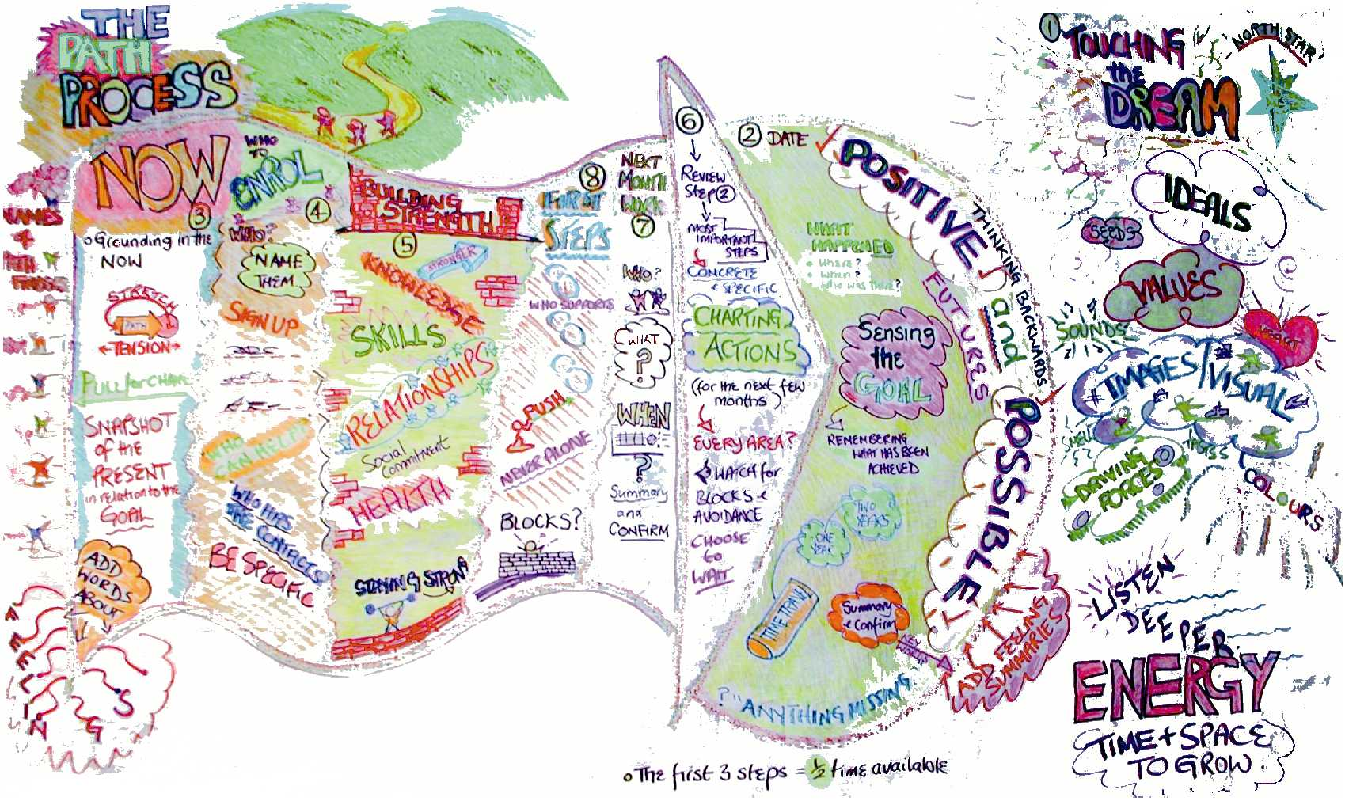
What is your Experience? How can this approach be used in your context?

