Slide 1
Campaigning for Human Rights
Lessons from History

Slide 2
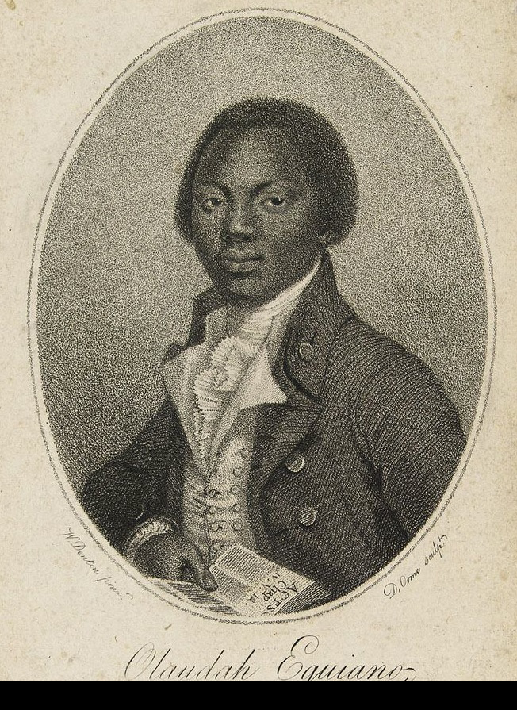
Olaudah Equiano (c. 1745 – 31 March 1797 Abolition of Slavery
"The first object which saluted my eyes when I arrived on the coast was the sea, and a slave ship, which was then riding at anchor, and waiting for its cargo. These filled me with astonishment, which was soon connected with terror, when I was carried on board. I was immediately handled, and tossed up to see if I were sound, by some of the crew; and I was now persuaded that I had gotten into a world of bad spirits, and that they were going to kill me." Olaudah Equiano, The Interesting Narrative of the Life of Olaudah Equiano (London: Printed for and sold by the author, 1790), p. 46

Slide 3
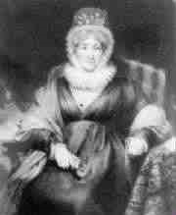
Mary Wollstonecroft –First Feminist
‘Vindication on the Rights of Women’ 1792
‘Let those who do not learn from history perish by it ‘
‘Women are capable of rationality; it only appears that they are not, because men have refused to educate them and encouraged them to be frivolous’.

Slide 4
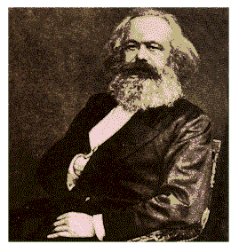
Karl Marx Political Philosopher
From each according to his abilities, to each according to his needs
The philosophers have already perceived the world in various ways; the point is to change it.

Slide 5
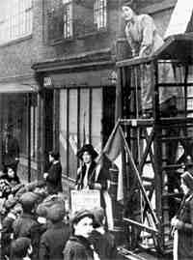
Sylvia Pankhurst Suffragette
Love and freedom are vital to the creation and upbringing of a child.

Slide 6
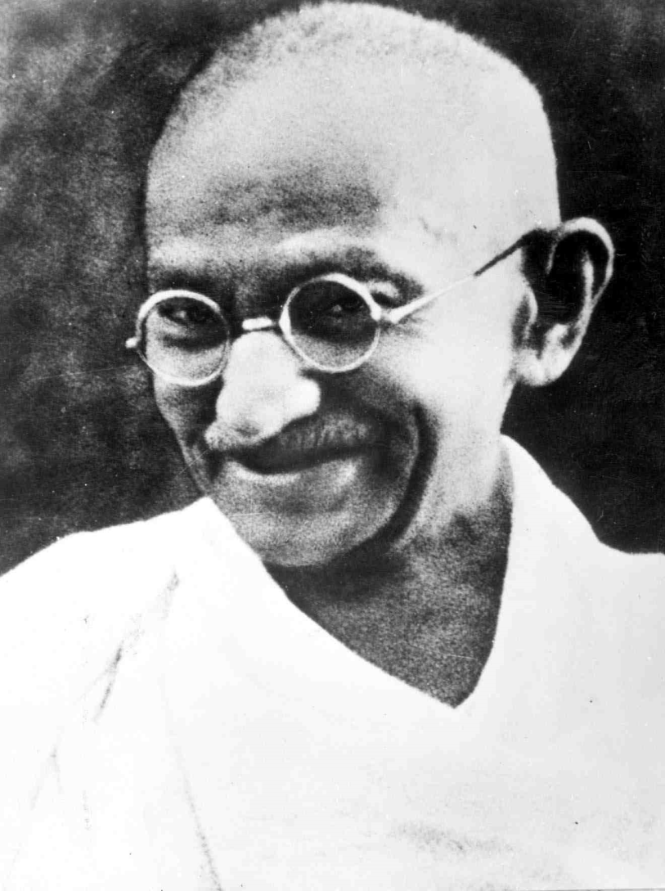
Ghandi
You have to be the change you want to see in the world

Slide 7
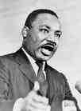
Martin Luther King American Civil Rights Movement
A right delayed is a right denied.
Nonviolence is the answer to the crucial political and moral questions of our time: the need for man to overcome oppression and
violence without resorting to oppression and violence. Man must evolve for all human conflict a method which rejects revenge,
aggression and retaliation. The foundation of such a method is love.
Martin Luther King, Jr., Nobel Prize acceptance speech, Stockholm, Sweden, December 11, 1964

Slide 8
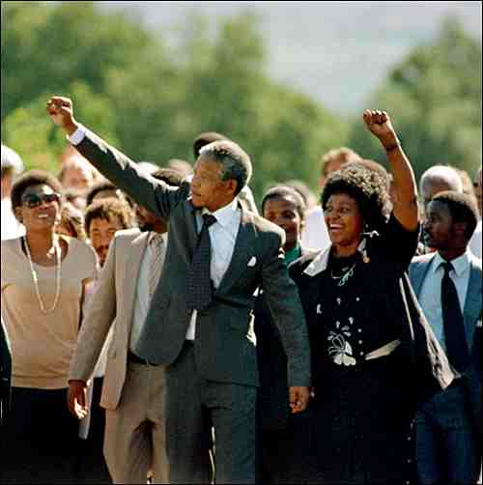
Nelson Mandela
Education is the most powerful weapon which you can use to change the world
For to be free is not merely to cast off one's chains, but to live in a way that respects and enhances the freedom of others

Slide 9
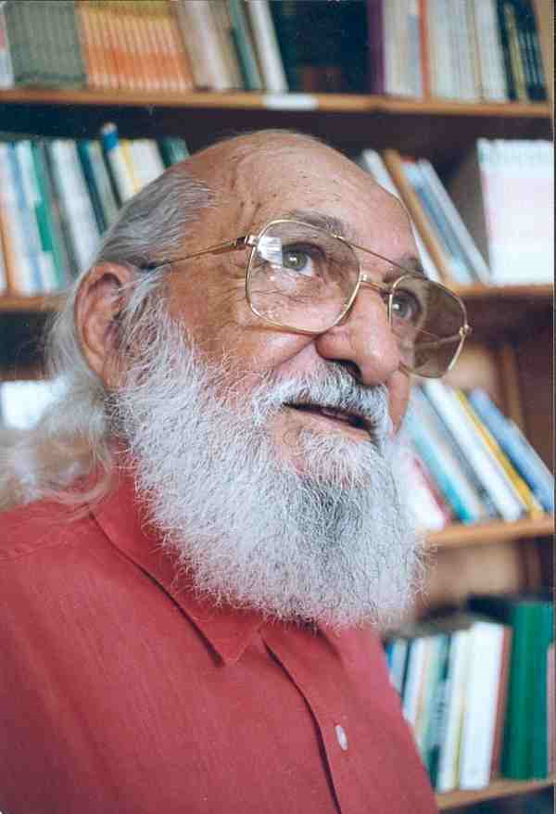
Paulo Freire
Washing one's hands of the conflict between the powerful and the powerless means to side with the powerful, not to be neutral.

Slide 10
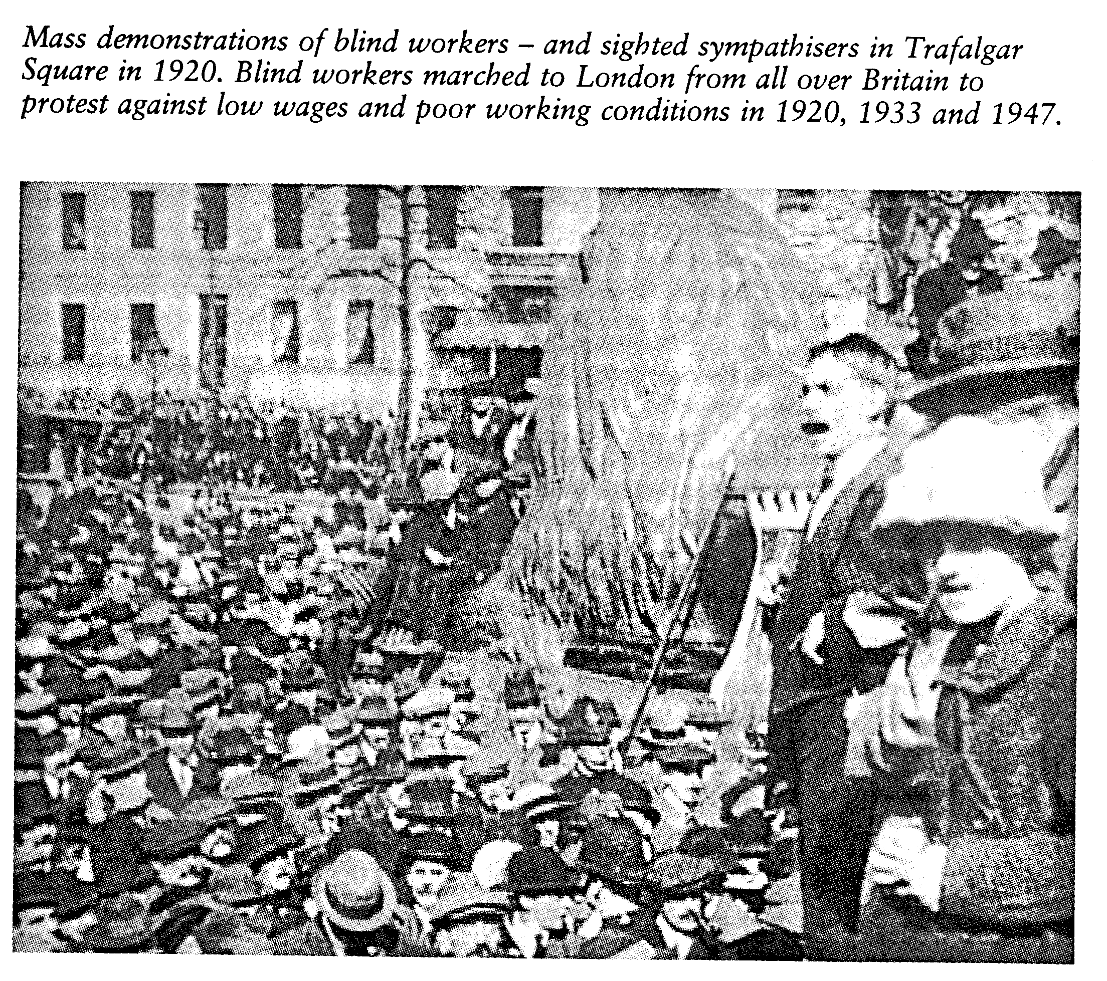
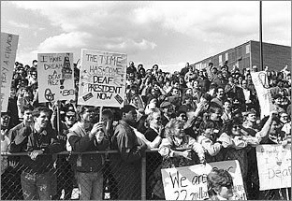
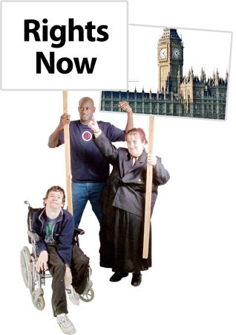
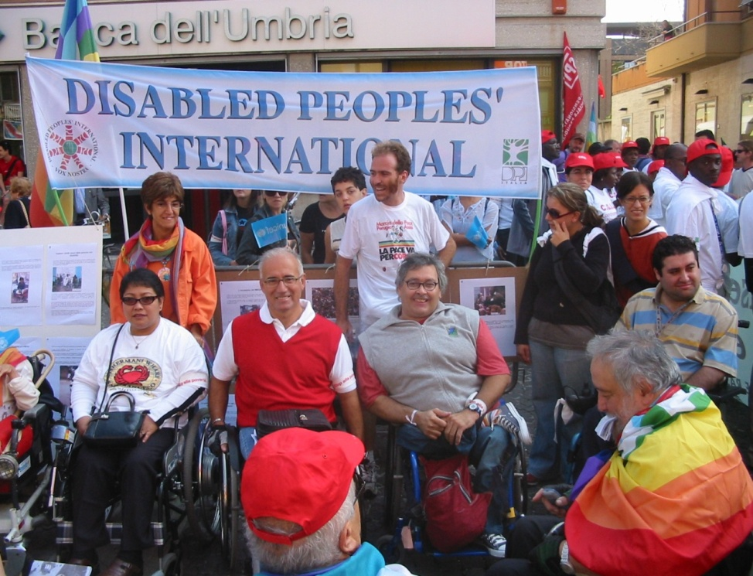

Slide 11
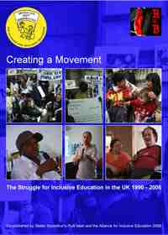
Nothing About Us Without Us
Building an Alliance for Inclusive Education.
Parents of disabled children
Disabled adults
Disabled children
Professionals
Allies

Slide 12
Building Campaigns
Power is ability to make your will felt in society
Developing a strategy analyse forces against you and potential allies
Develop a list of demands
Develop a campaign to get these demands implemented
Use the media and internet-use stunts to get media attention
Get support from other civil society organisations eg trade unions or churches

