Slide 1
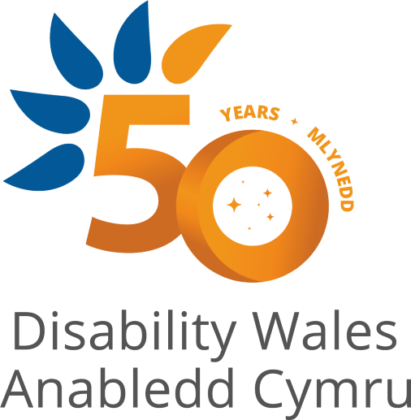

Disability History Examples
Place them against the timeline
Disability, UNCRPD and Curriculum for Wales
World of Inclusion Ltd

Slide 2
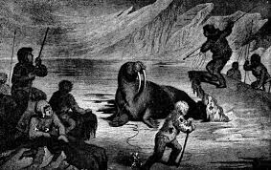
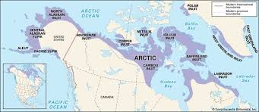
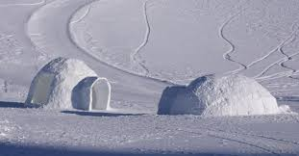
Inuit people of far north American continent expect their disabled people to die when they can no longer feed themselves.
They go off into the snow to die

Slide 3
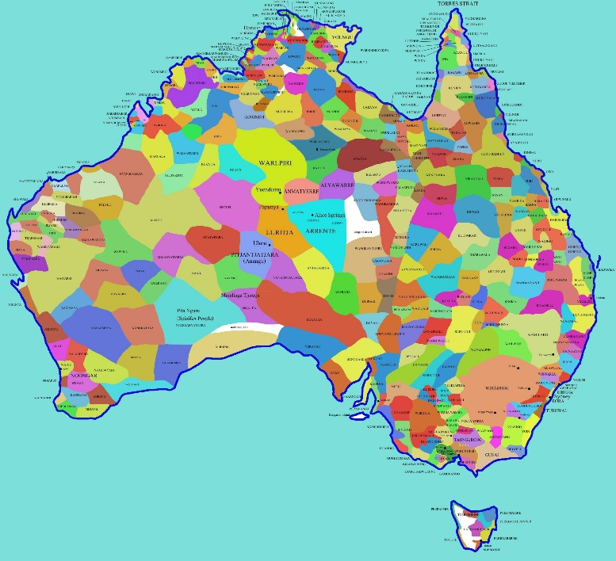
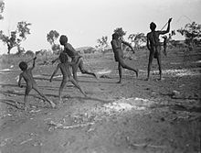
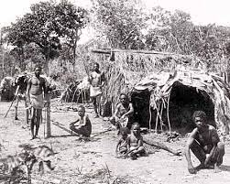
Other Hunter Gatherer peoples, such as Northern Territory Aborigines, carry for long periods those who cannot walk.
Aboriginal Tribal Lands

Slide 4
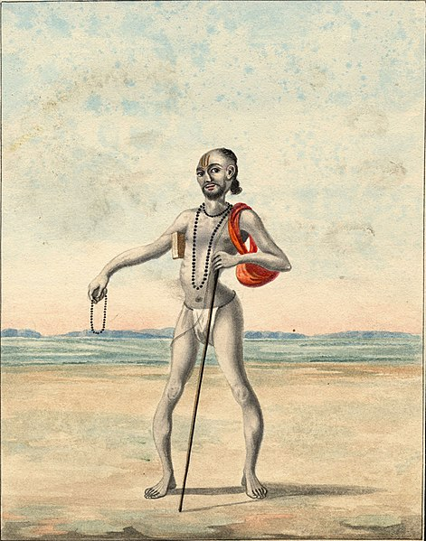
Ancient India
Aṣṭāvakra, born with multiple physical impairments, grows up to be a celebrated Hindu sage.
Queen Vishpala. 3500 BC in India Ancient Poem Rig-Veda which describes the life of the disabled warrior Queen Vishpala.
She had lost a leg during a fierce battle and was fitted with an iron prothesis which enabled her to return to the battlefield and “achieve much glory”.

Slide 5
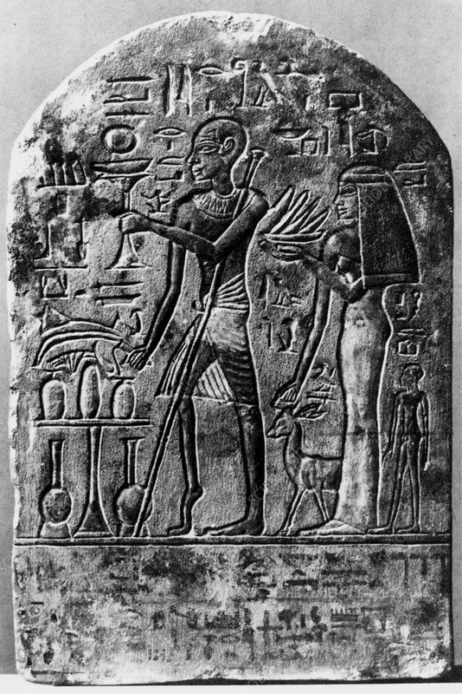
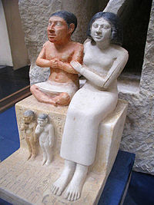
Ancient Egypt
Left. Senab, a high ranking ancient Egyptian official c.2520 BC. Right. Bes one of the Gods
From 1500 BC an image from Ancient Egypt uncovered base relief polio survivor

Slide 6
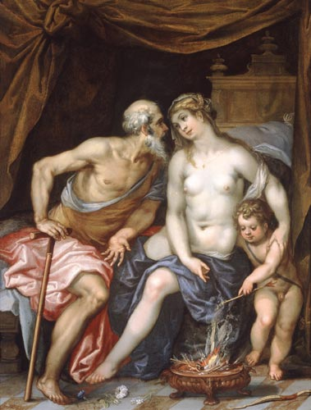
Ancient Greek
The club footed God, Hephaestus, having survived being cast out of Heaven by his mother, Hera, because of his impairment, worked as a blacksmith, giving him incredible strength
Aristotle and Plato promulgate Eugenics leading to exposure of disabled babies as in Sparta.
Lycurgus, the quasi-legendary Spartan lawgiver, and orator stated:
“children are state property and that those born puny and ill shaped’ should be disposed of.”

Slide 7
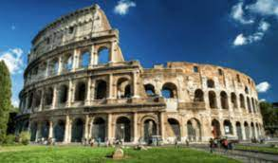
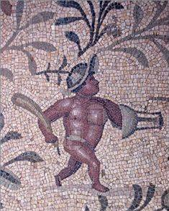
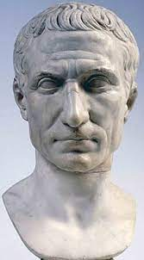
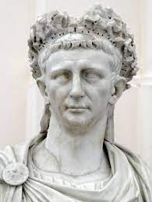
ROME
In 41 AD The Roman Emperor Claudius wrote about how his physical impairment (a stammer and walking with a limp) was often mistaken for mental impairment, and how his family tried to keep him out of the public eye. His family distained him. He was fortunate not to have been thrown into the river Tiber at birth, as was the usual case with children born with any physical impairment.
Disabled Gladiators were a favourite with the crowded Coliseum.
Commodus liked to fight in the arena. When he did fight, he fought
disabled gladiators, including dwarfs and those missing limbs
Julius Cesar had Epilepsy which he disguised
Dwarf gladiator, Villa Sileen, Tripoli.
Hunchback to ward off bad luck, Antioch c.2nd AD

Slide 8
Vikings-Ivarr the Boneless
In 865 AD the infamous disabled Danish Prince Ivarr the Boneless, paralysed from the waist down was, according to chronicles of the time, carried around on a Viking round shield and driven in a custom-made chariot. It is likely he was partially paralysed or had Brittle Bones. In the televised adaptation ‘Vikings’ researchers also discovered that he had ‘walked’ with the aid of leg braces and crutches.
Ivarr and his brothers Halfdan and Hubba invaded Great Britain in the year 865 at the head of a large Viking force described by fearful Christians as the “Great Heathen Army.”

Slide 9
Medieval Church and Disability
Stained glass window Saint William, healing a blind woman, York Minster, 1215. Tomb of St Cuthbert paralysed man, Bede 1200. The Holy Grail is carried to Jerusalam (La Queste del Saint Graal, Fance, 1316). Note the lame man cured by contact with the grail, helping the knights carry it.

Slide 10
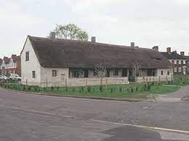
Luttrell Psalter 1325 AD
Leprosy bacteria came to UK with returning crusaders and spread. Lepers Hose Taunton established by Henty III under Abbots of Glastonbury

Slide 11
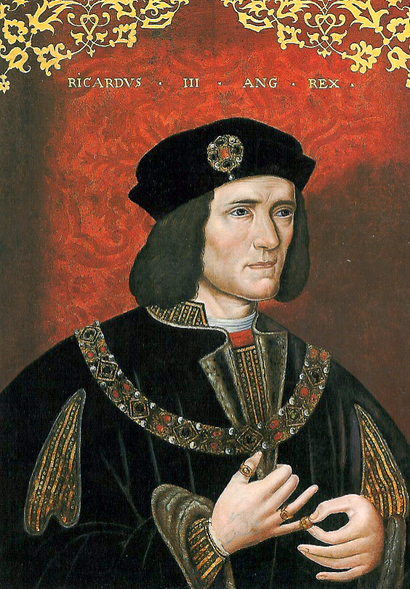
Richard III :Henry VII Tudor king from Pembroke demonised the last Plantagenet King 1483-85
Shakespeare describes Richard in the following way: “unfinished, a lump of foul deformity, inhuman, unnatural, misshapen, with a dissembling nature, a rooting hog, the slander of his mother's womb, the loathed issue of his father's loins, a yonder dog, a hell hound, a carnal cur, a bloody dog, scum, and vomit.”
To historians, the evil deeds of Richard swirl in controversy and dispute but his achievements are not in doubt.
He was a good and honest administrator.
He strengthened the jury system.
He created a system of bail for those accused of crime.
He strengthened the fiscal system.
He strengthened freedom of religion.
He pardoned his enemies and tried to reunite his wounded country.
He was personally devout, honorable, and courageous.
He was devoted to his family and grievously mourned the wife and child who preceded him in death.

Slide 12
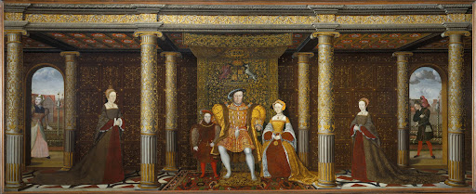
Tudors Henry VIII Family Portrait (1545)
The English King Henry VIII had a favourite painting – Family Portrait (1545) painted by an unknown artist. It was not a completely realistic portrayal as Jane Seymour the King’s wife was dead. Left to right: Princess Mary, Prince Edward, the King, Jane Seymour and Princess Elizabeth. Far left, Mother Jak, a female jester with learning difficulties. Far right, Will Somner the Jester, hunchback and natural fool. The Tudors believed people with learning difficulties spoke the word of God and had them live at Court, to give honest answers and amuse them. More information and a re-creation at www.allthekingsfools.co.uk/site/

Slide 13
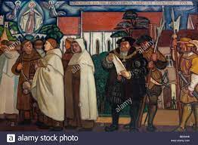
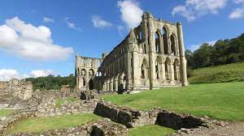
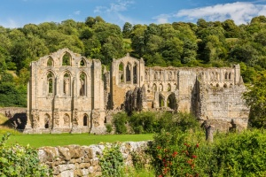
Dissolution of Monasteries 1533 to 1545
In the Middle Ages Care for the sick and the disabled was based on the Church teaching of the seven ‘comfortable works’. These involved feeding, clothing and housing the poor, visiting them when in prison or sick, drink for the thirsty and burial. There were also seven ‘spiritual works’ which included counsel and comfort for the sick.
Disabled people were not passive recipients of care. In 1297 the residents of the leper house in the Norfolk village of West Somerton mutinied against the embezzling prior and his men, looting and demolishing the buildings and killing the guard dog. Most people lived outside specialist buildings, in their communities, working if they could, supported by family, friends and sometimes the municipality if they could not. The dissolution led to many disabled people thrown back on begging and Poor Laws. (Disability Time and Place, English Heritage).

Slide 14
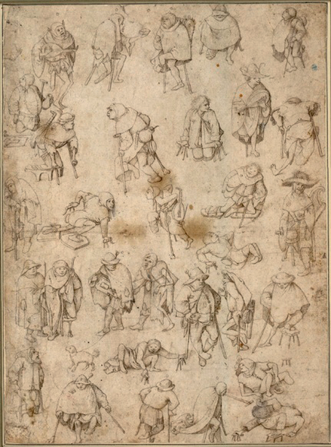
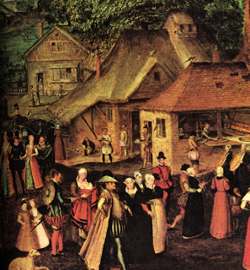
Life in 16th Century
Most other disabled people lived in their communities, with their families. They married and had families. They worked, unless their disabilities were so extensive as to make work impossible.
The city of Norwich conducted a ‘census of the poor’ in 1570. Information was gathered about the lives of 1,400 of the poorest people in the city. Among them were 63 disabled men and women who had ‘lameness’ or ‘crookedness’ of the arms or legs, missing limbs, blindness or deafness. Their lives were surprising. Although poor, many were in work. The women were spinners or knitters, some of the ‘lame’ men were labourers. Nearly all married to non disabled partner.
A series of Poor Law Acts enforced vicious punishments, including whipping and branding, for ‘sturdy vagabonds’ who were seen as idle by choice. But the ‘impotent poor’ were seen differently. ‘The person naturally disabled, either in wit or member, as an idiot, lunatic, blind, lame etc., not being able to work…all these… are to be provided for by the overseers of necessary relief and are to have allowances … according to…their maladies and needs.’

Slide 15
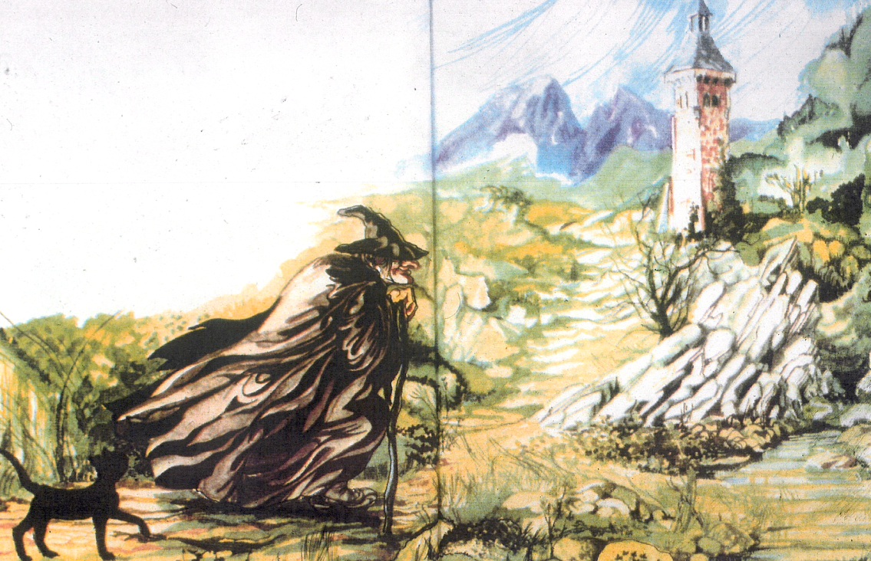
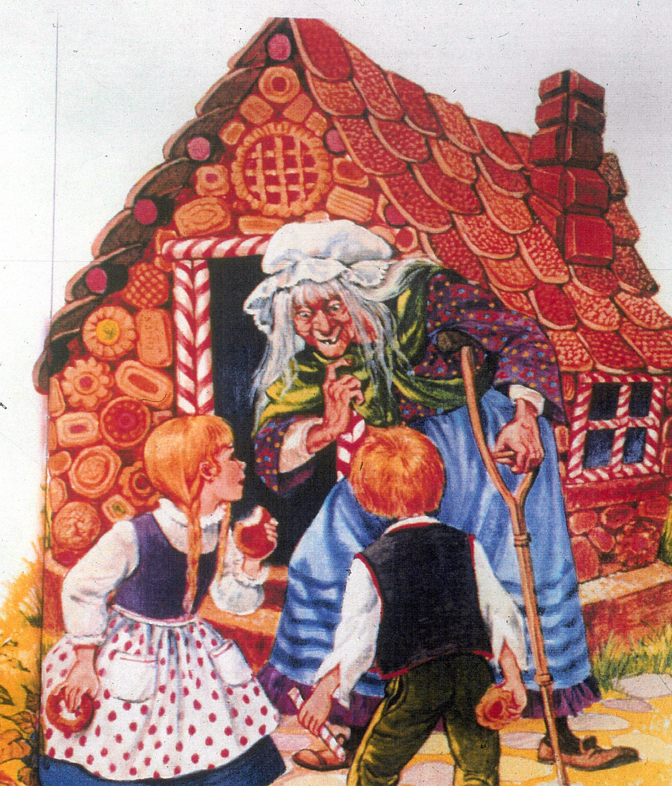
Rapunzel
Where did these stereotypes come from?
The Great Witch hunts of Europe
1480-1680
8 million killed
Disability or birth of a disabled child was proof positive of witchcraft
Hansel and Gretel
Examine traditional tales for treatment of disabled people. If negative re-write

Slide 16
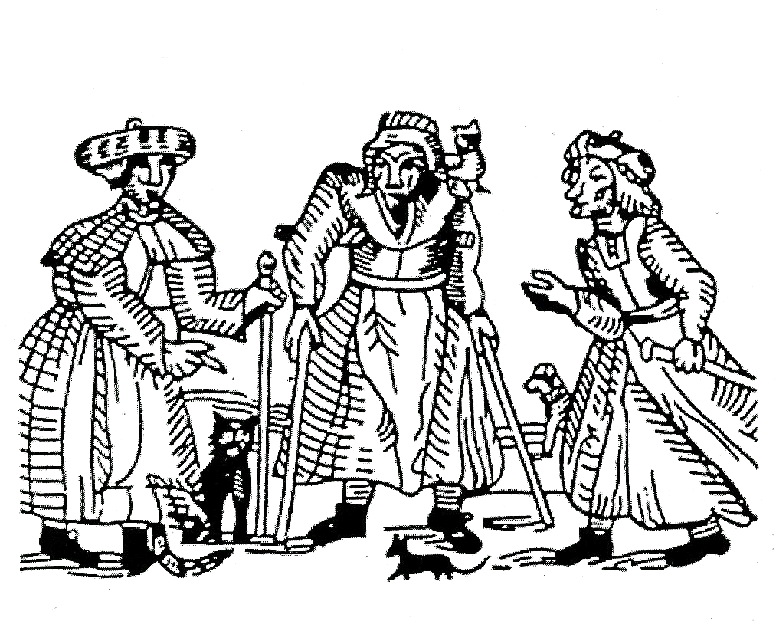
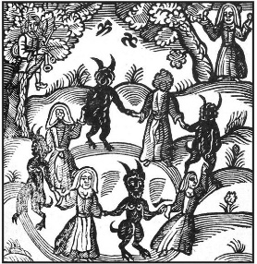
Witch Hunts
Evil continued during European witch hunts, aimed largely at women. Disabled women have always faced this stigma. Many women with mental health conditions – along with older people showing signs of dementia, and people with benign and cancerous growths – were caught up in the European witch-hunts of the 17th century. One observer at the time, Reginald Scot (a Justice of the Peace in Kent), noted that they were “commonly old, lame, blear-eyed, pale, foul, full of wrinkles…lean and deformed showing melancholy in their faces to the horror of all that see them.” But the combination of impairment and patriarchal sexism meant witches and later other women, especially with learning difficulties, were accused of hyper-sexuality and licentiousness; having intercourse with the Devil. This has led to persistent abuse of disabled women, particularly in institutions, where they have been raped and abused for centuries

Slide 17
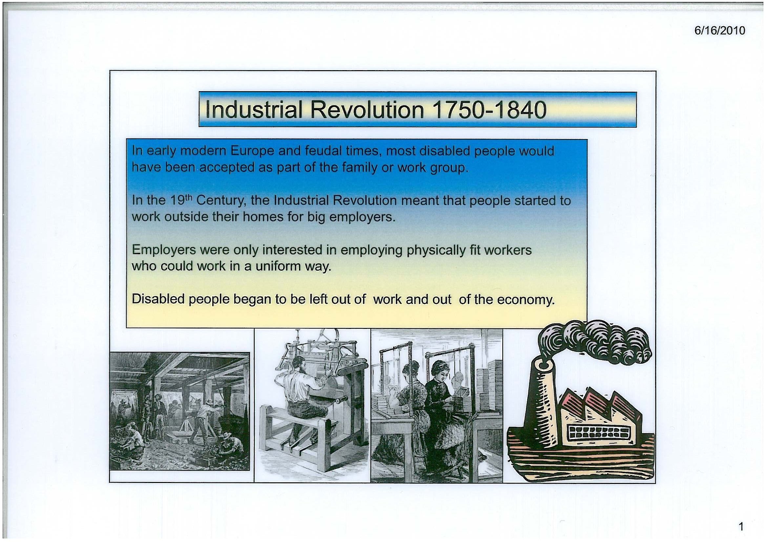
The Long Eighteenth Century 1660-1832
A growth in hospital, private houses for well of lunatics and the first special schools were through charitable endeavours planting the seed of segregation.
Increasingly the old farming a system or cottage industries where the whole family worked together were breaking down and people were moving to the new factory production

Slide 18
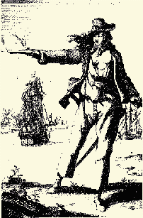
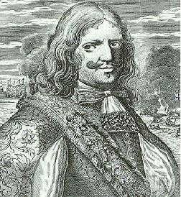
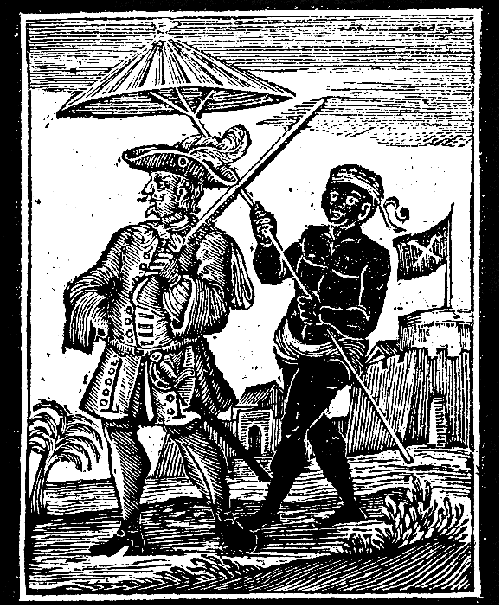
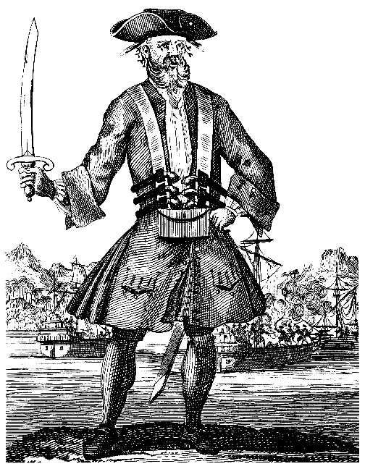
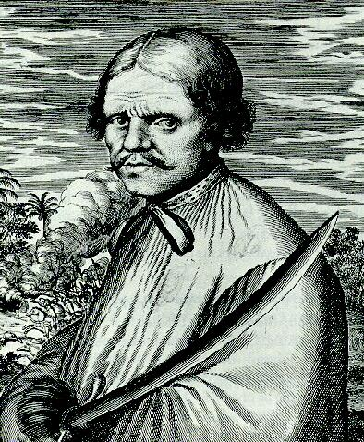
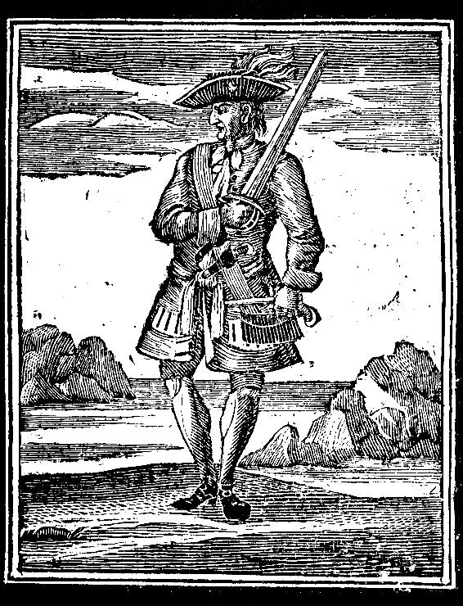
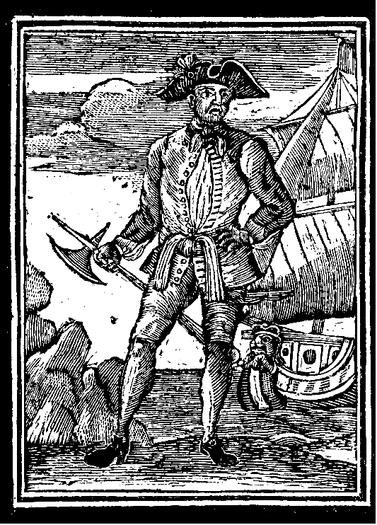
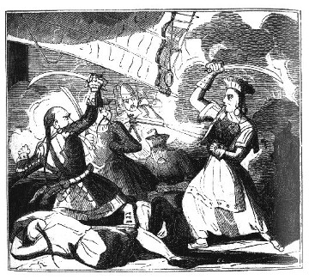

16th and 17th Century
Blackbeard- Edward Teach
Ann Bonny
Francis Morgan
Captain Every
Edward England
Roche Brasiliano
John Rackham
Madame Cheng Shih 1836

Slide 19

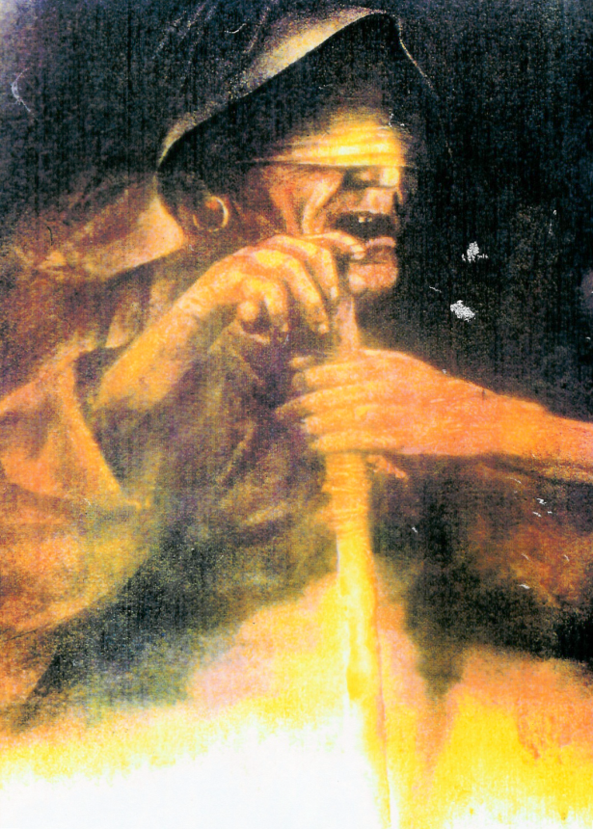
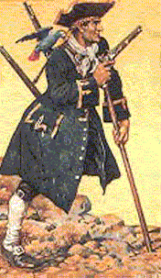

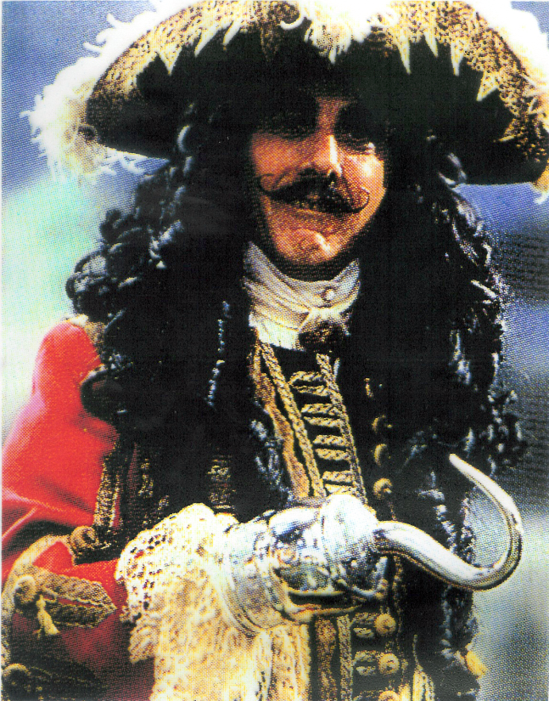
Blind Pugh
Long John Silver 1850
Were Pirates Always Disabled?
Hook

Slide 20
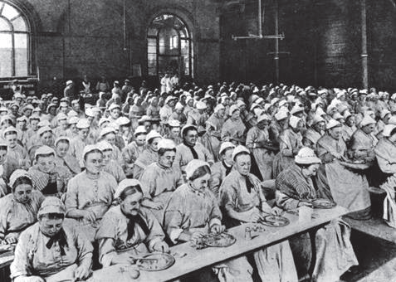
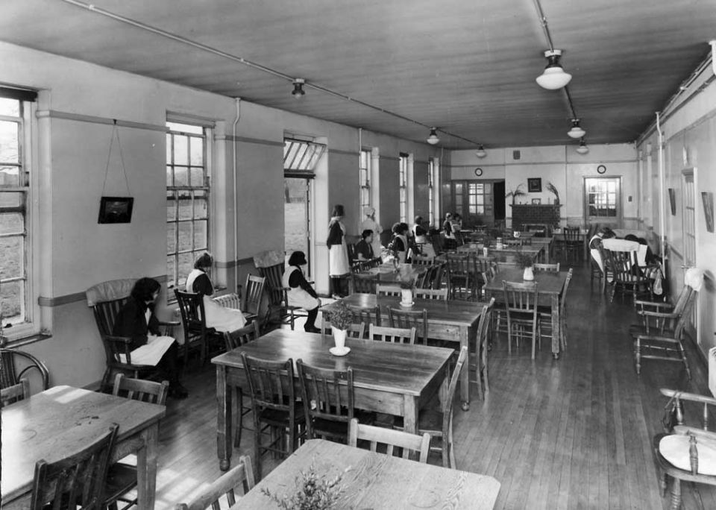
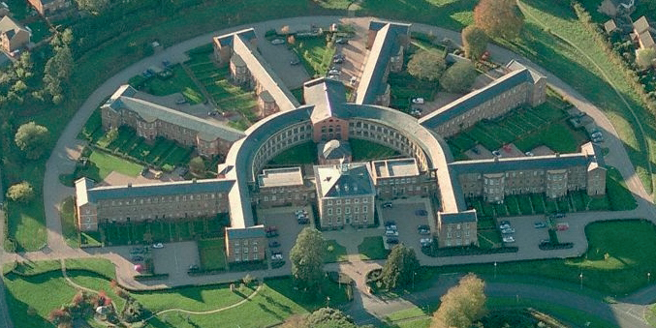
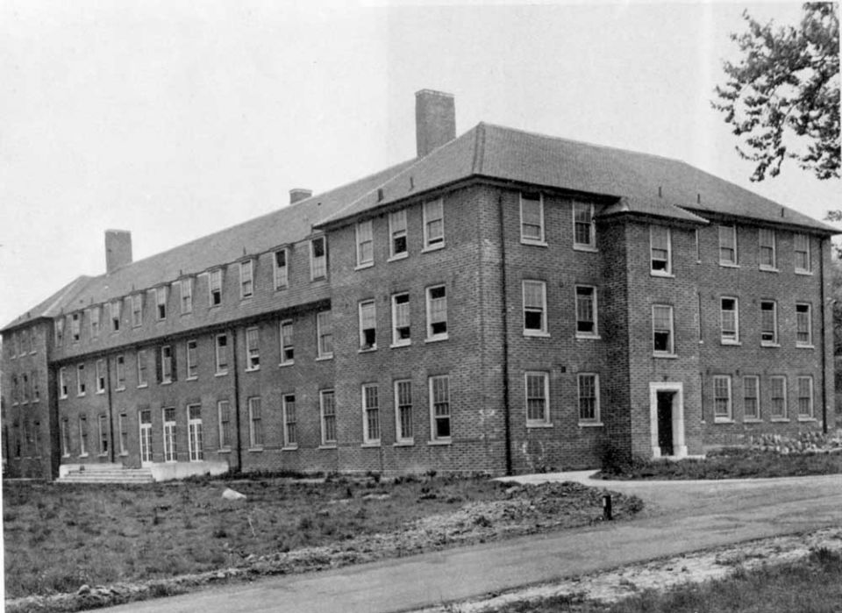
Long Stay Institutions incarcerate us
1834-1970s
Work House
Mental Deficiency Hospital
Asylums

Slide 21
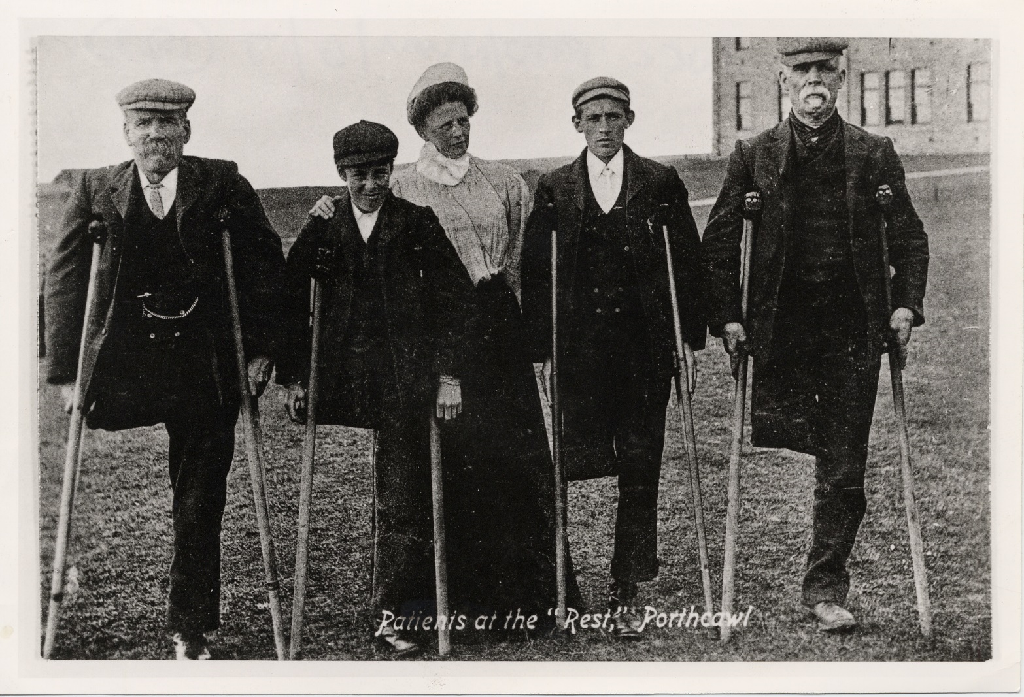
Mining was a dangerous industry & caused much impairment in South Wales 1880 - 1946
The coal measures were difficult to work. The coal owners were ruthless and there were many injuries and deaths. Miners friendly society and the Union provided the support and rehabilitation back to work often on the surface . This was before NHS.

Slide 22
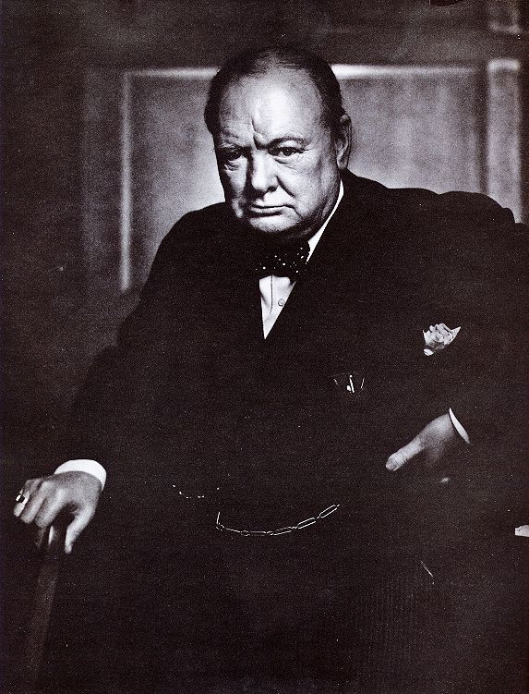
Eugenics and Mental Deficiency Act
Idiots
Imbeciles
Feeble Minded
Moral Defectives
150,000 locked away
“The unnatural and increasingly rapid growth of the feebleminded classes, coupled with a steady restriction among all the thrifty, energetic and superior stocks constitutes a race danger. I feel that the source from which the stream of madness is fed should be cut off and sealed up before another year has passed.”
Winston Churchill MP, Home Secretary at the time the Mental Deficiency Act of 1913 became law.

Slide 23

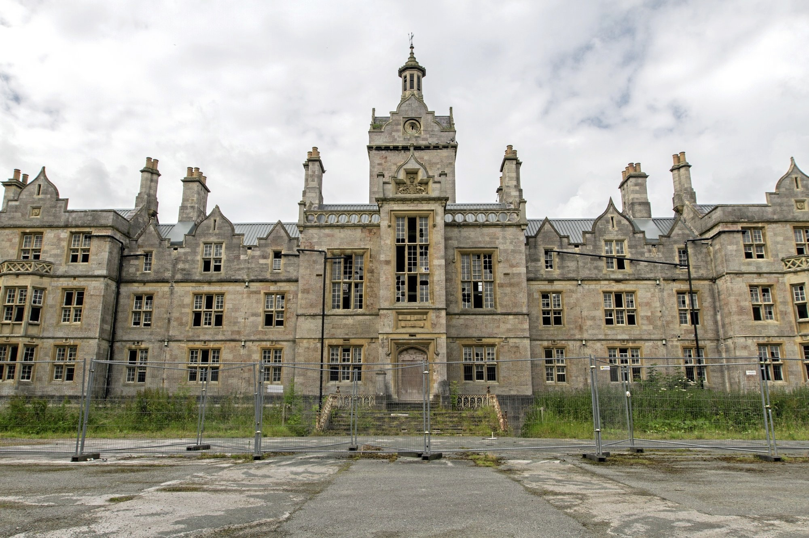
Asylums in Wales
The Asylum Act 1850 required county councils to build them.
Restraint and padded cells were used in the earlier days to be replaced by psychotropic drugs. In the mid C20th lobotomy and electro convulsive therapy were widely used, which are invasive and against the UNCRPD today. Welsh relics of these times of incarceration abound.
The history is fascinating and can be traced on websites such as https://www.countyasylums.co.uk/ -Talgarth, Mid-Wales 1903-1997, 350 patients; Cefn Coed, Swansea 1932-2018;Haverfordwest, Pembrokeshire 1822-2007, Pen-y-Fal, Monmouthshire 1851-2007, Denbigh 1848-1996 753 patients; Parc at Bridgend, 1886-1996; St.Cadoc’s, Newport 1906-still open 504 patients in 1961 and Whitchurch, Cardiff City 1908-2016 (now National Cancer Centre).
Denbigh Mental Asylum 1848-1996

Slide 24
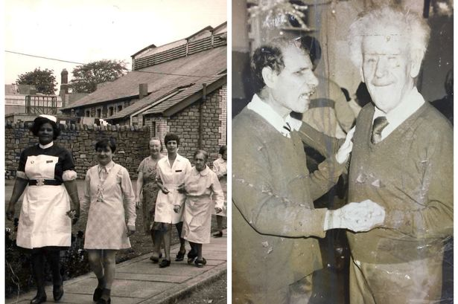
Mental Deficiency Act Wales
Bryn-y-Neuadd, LLanfaifechan until 1967 housed 300
Llanfrechfa Grange Hospital, Newport from 1953 had 500 inmates reducing to 200 in 1982 and finally closed in 2008
Hensol Castle in Glamorgan opened as a ‘colony in 1930 with 100 male inmates, by 1935 with 460 adding women and children. Post war when taken over by NHS went up to 800 inmates. Closing in 2003
Ely Hospital in Cardiff, . In 1930 control of the institution passed to the Public Assistance Committee of Cardiff City Council. Then passing to NHS in 1947, numbers incarcerated grew with 483 incarcerated in 1967. In that year the News of the World broker a story of bullying, abuse of inmates which led to an inquiry in 1969. Leading to eventual closure
The UK Mental Deficency Act of 1913 firmly categorised disabled people, as follows:
Idiots - persons unable to guard themselves against common physical dangers.
Imbeciles - persons incapable of managing themselves and their affairs or, in the case of children, of being taught to do so.
Feeble minded - persons they require care, supervision and control for their own protection or for the protection of others. Or, in the case of children, that they appear to be permanently incapable by reason
Moral defective - persons in whose case there exists mental defectiveness, coupled with strong vicious or criminal propensities e.g tramps or unmarried women pregnant

Slide 25
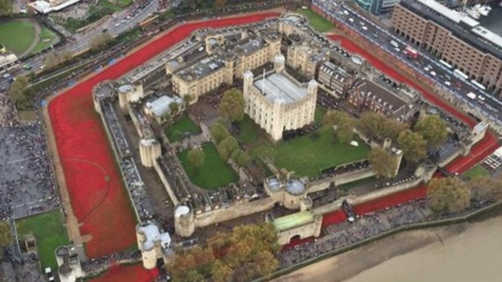

1914-1918
888,246 British Military Dead
Each Ceramic Poppy for a British Service Person Killed in 1st WW
What about the 2,400,000 who came back as disabled people?
Was it ‘a Land Fit for Heroes’?

Slide 26
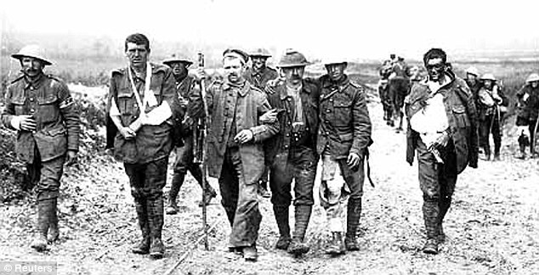
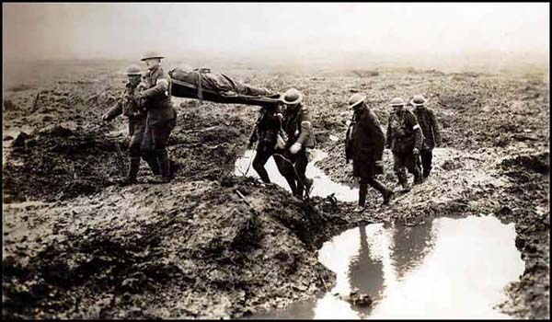

First World War
52 months 5000 soldiers died on average every day.
More than double that number had long term life limiting impairments.
The first industrial and total war.
Shrapnel, machine guns and gas brought high casualties and deadlock
Worldwide 16 million dead, 20millionn disabled
UK 880,000 dead and nearly 2.4 million disabled
What happened to them?

Slide 27






American Casualty Ratio: The impact Medical Progress
War | Service People Killed | Disabled Wounds not mortal | Percentage Injuries lead to Death
US Civil War Union side 1861-1865 | 364,511 | 281,881 | 56%
World War 1 | 116,516 | 204,002 | 36%
World War 2 | 405,399 | 671,846 | 37%
Korean War | 36,516 | 103,284 | 26%
Vietnam | 58,198 | 153,303 | 27%
Wars Since 2001 | 6,809 | 52,010 | 8-13%

Slide 28






UKDHM- First World War- Black
Involvement 1914-1918
1.4million soldiers from Greater India
47,746 dead 65,126 wounded
500,000 Africa 71,000 dead 100,000 wounded
West Indies Regiment 15,000

Slide 29


Disabled Veterans
Struggle for Rights 1919
Despite some in initial activism from Discharged Soldiers and Sailors Federation.
Charity prevailed with setting up of the British Legion.
“Instead of demanding our rights we went hat in hand asking for charity. We ought to have gone bayonet in hand demanding our rights.”
King’s National Roll. Many never got a job.

Slide 30

1920 Blind Trade Unionists March from Cardiff to London demanding fair pay and to stop exploitation in the Blind workshops

Slide 31
Getting Rid of the ‘Useless Eaters’ in Nazi Germany 1933-1945
This led to
1 million disabled people being killed in Greater Germany by 1946 as a
BURDEN

Slide 32


UKDHM UKDHM Logo
Reclaiming our history
Inverting Nazi Symbol
Black Triangle
Compulsory Sterilisation 1933
Mass murder 1939- 1940 T4 Programme -250,000-1m

Slide 33





Challenging Charity for a living wage! Demanding the right to drive an ordinary car!

Slide 34



Paul Hunt writes to Guardian September 20th 1972. From this the Union of the Physically Impaired Against Segregation is Formed (UPIAS) . The Social Model is invented.
By 1981 The British Council of Disabled People is formed and adopts distinction between impairments and disability
“Impairment is the functional limitation within the individual caused by physical, mental or sensory impairment.
Disability is the loss or limitation of opportunities to take part in the normal life of the community on an equal level with others due to physical and social barriers” .

Slide 35

By 1981 The British Council of Disabled People is formed and Adopts distinction between impairments and disability
“Impairment is the functional limitation within the individual caused by physical, mental or sensory impairment.
Disability is the loss or limitation of opportunities to take part in the normal life of the community on an equal level with others due to physical and social barriers” .

Slide 36

Social Model 1970s/1980s
Those with impairments disabled by society’s attitudes and barriers
roots: disabled activists and academics
Problem: social and attitudinal barriers, capitalism/corporatism
Solution: activism, policy change, independent user-led organisations active in leading challenges

Slide 37





1920, 1933, 1947 Demonstration for the Right to Work and for decent wages and conditions for Blind Workers
British Council Disabled People 1972
Disabled People Organise and Fight Back
People First- People with learning Difficulties 1984

Slide 38



Impacts
BCODP formed 1980
Disabled People International adopt 1981
Disability Living Allowance
Motability
Independent Living Fund
Disability Discrimination Act 1995 ( passed on 17th attempt)
Section M Building Regulations
SEN and Disability Act 2001
Disability Amendment Act 2005
Life Chances Report Equality 2025
Equalities Act 2010
UN CRPD

Slide 39


Slide 40


Slide 41


Slide 42


Wales 2019-2021 Locked Out
68% of Deaths from Covid in Wales were Disabled People
Natasha Hirst, chair of the NUJ's Disability Council, told the 2022 TUC Disabled Workers Conference almost seven out of ten people (68 per cent) who died from Covid-19 in Wales were disabled people. She said the Welsh Government's Disability Equality Forum report on the impact of Covid-19 on disabled people in Wales, highlights the appalling consequences for disabled people throughout this pandemic. Caused by institutionalised ableism; inaccessibility; exclusion; entrenched discrimination; isolation; trauma; erosion of voice, choice and control.
"Our exclusion is driven by political and social attitudes. We are not valued. Our differences and talents are not embraced. When governments deprioritise us, so do employers, service providers and everybody else. We have experienced how easily in a crisis our human rights are discarded. That is why we need more disabled people in leadership roles. And more disabled activists in our unions."

